Slide 1

CSS GRID & FLEXBOX
MODULE 3, DAY 3
Notes:
https://bitbucket.org/te-curriculum/te-curriculum-v1/src/0b76a9a78a19f32fba58df0b3e067085db24bade/module-4/10_CSS_Selectors/lecture-notes/lecture-notes.md

Slide 2
PULSE SURVEY

Slide 3
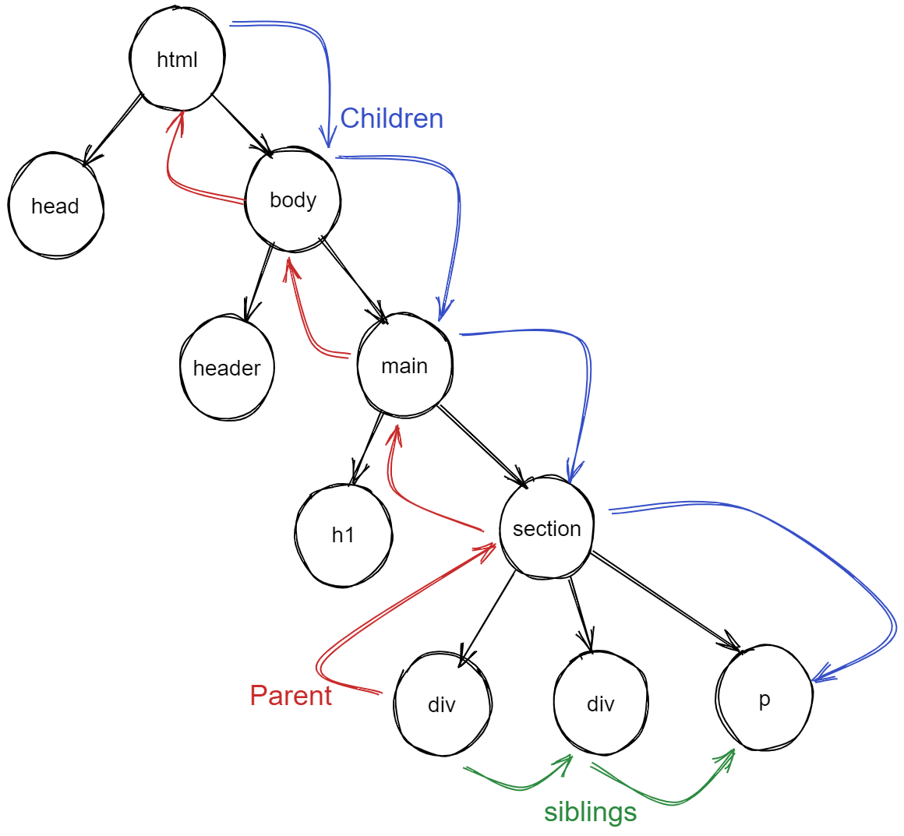
<html>
<head></head>
<body>
<header></header> <main> <h1></h1>
<section>
<div></div>
<div></div>
<p></p>
</section>
</main>
</body>
</html>

Slide 4
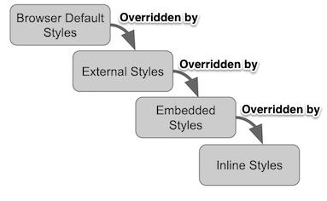
Cascade
Cascading Order
Highest Priority
Inline Styles
Internal Styles
External Styles
Browser defaults
Last Rule
If two selectors are identical, the later of the two will be applied
Specific
The most specific selector will be applied. h1 {} is more specific than * {}
!Important
indicates that this rule is more important than previous rules that may be applied.
Cascade: All CSS applied to an element, including from multiple style sheets, are brought together and then the most specific applied.

Slide 5
CSS Selectors continued...
https://v2-3-techelevator-book.netlify.app/content/css-selectors-box-model.html#advanced-selectors
Universal Selector: *
Element Selector: div
Class Selector: .spanOne
Id Selector: #divThree
Descendent Combinator: .special h2
Child Selector: #divThree > span
Adjacent Sibling Selector: .spanOne + span
(aka immediately following)
General Sibling Selector: .spanTwo ~ span
Pseudo-class Selector: div :first-child div :last-child div :nth-child(2) div:hover
List of Pseudo-classes
Selector CodePen

Slide 6
In the previous example, you defined the container as 500px in height. In this scenario, you know that the middle row is 300px because the container has a fixed height. What if you want the container to stretch the entire height of the viewport?
There are two CSS units of measure that allow you to do this:
vh: Relative to 1% of the height of the viewport
vw: Relative to 1% of the width of the viewport
You can use vh to set the height of the container. In this example, you'd define the height as 100vh to set the container's height to be 100% of the viewport. Using vh and the fr unit, you can define three rows that evenly stretch the entire height of the screen:
https://v2-3-techelevator-book.netlify.app/content/css-grid.html#css-units-vh-and-vw

Slide 7
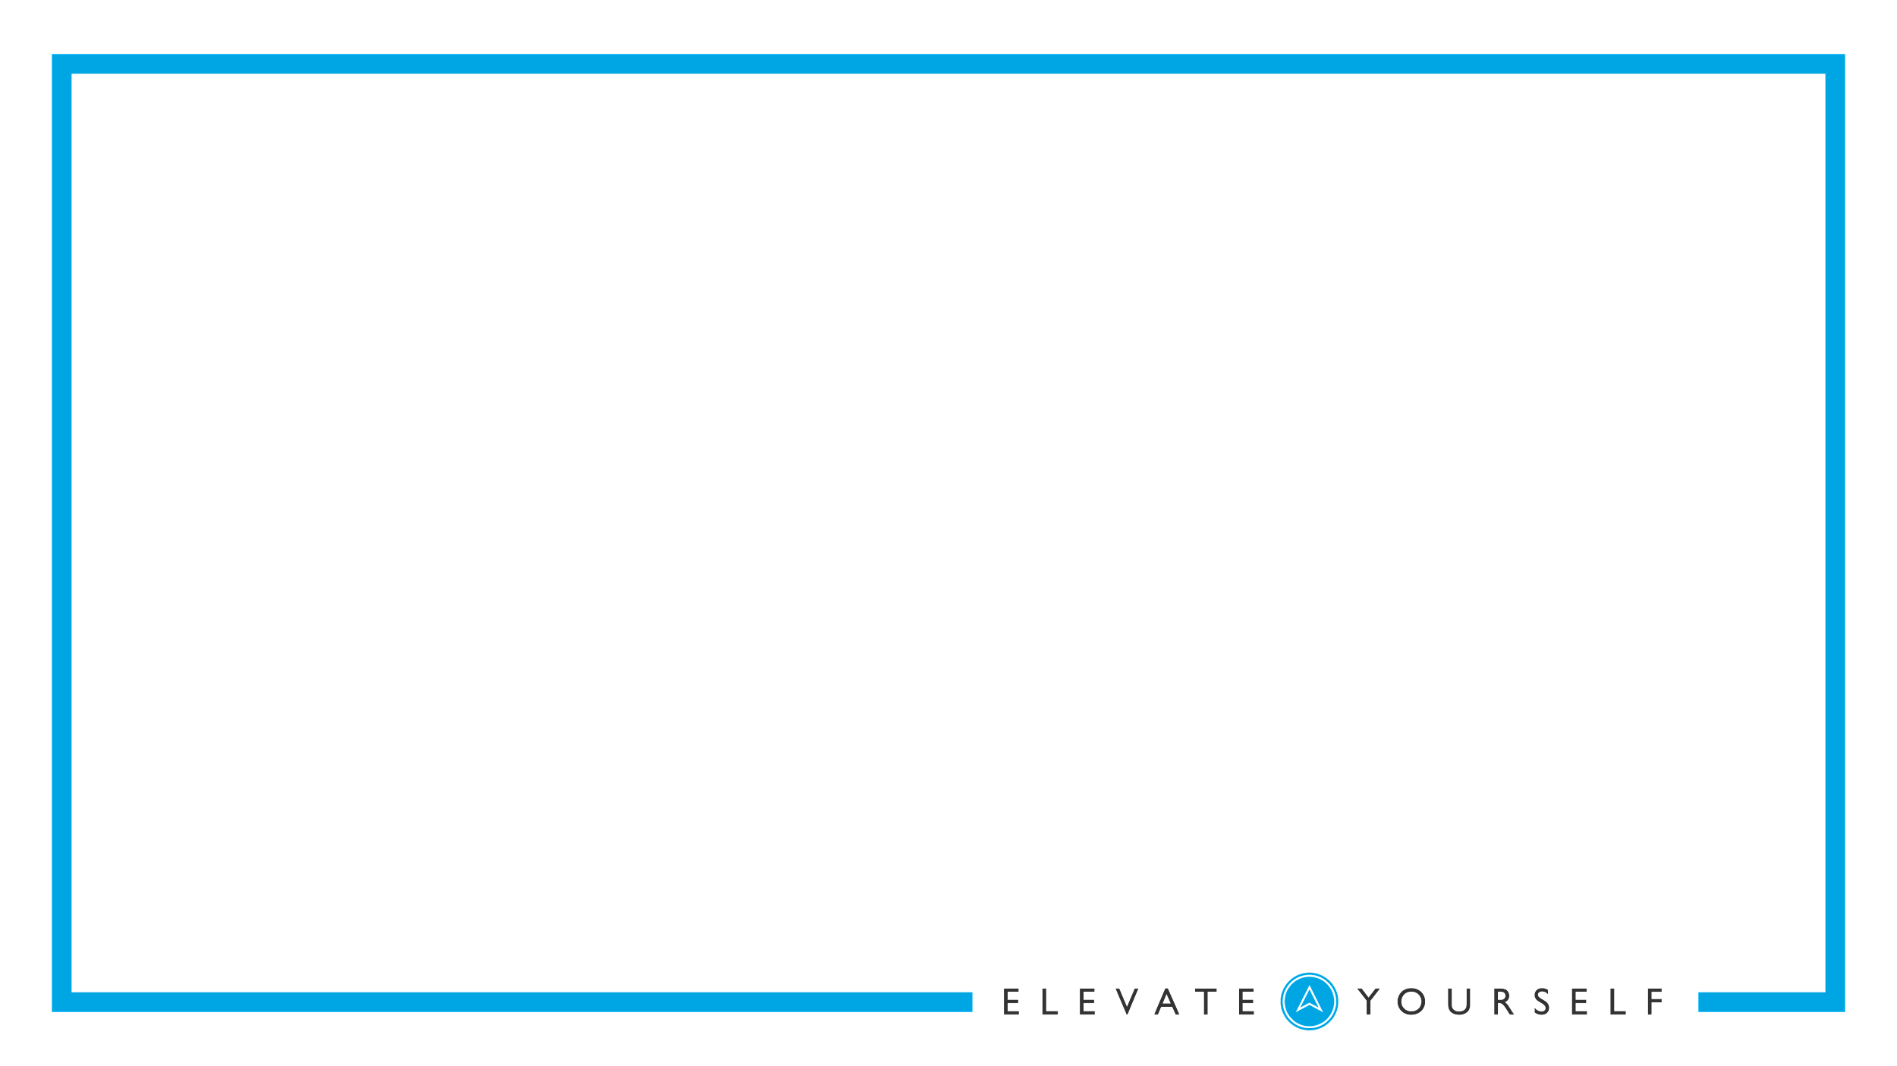
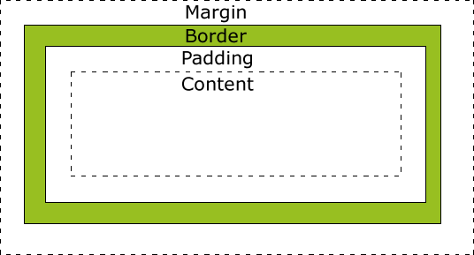
BOX MODEL
Every element in web design is a rectangular box.
The content, padding, border, and margin can be used to calculate the amount of space that an element takes up.
Margin is the space outside an element. It does not affect the size of the box but affects other content that interacts with the box.
Padding is the space inside an element.

Slide 8
DISPLAY:
block
Starts on a newline
Takes up full available width
can set width/ height
inline
Starts on same line
Takes up only width required for content
It accepts margin and padding while ignoring height and width
inline-block
Like inline
Can set width/height
content
a
content
content
a
a

Slide 9
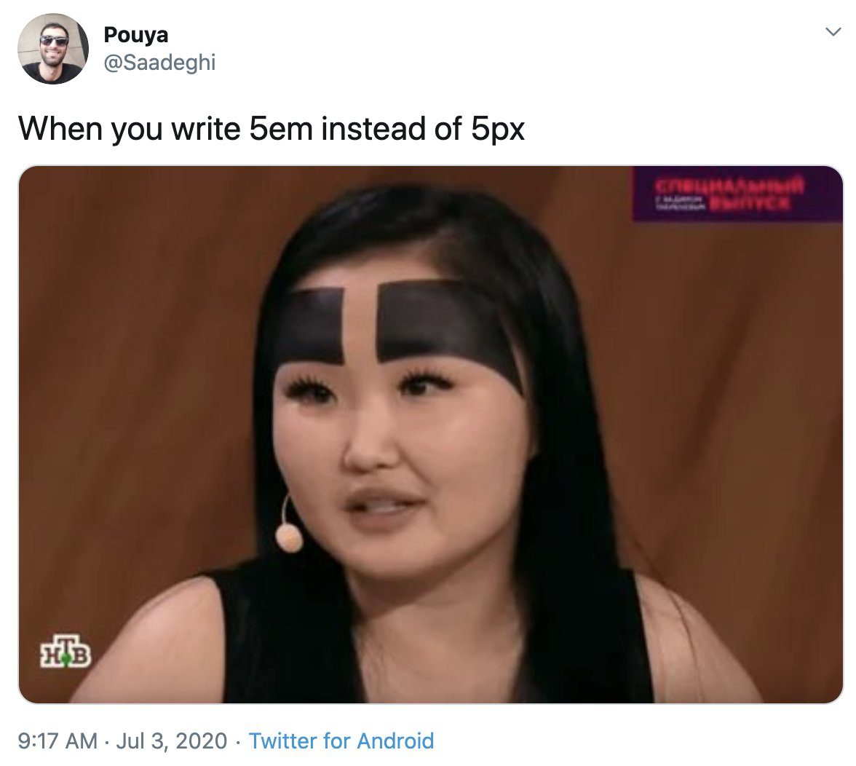
SIZE UNITS
px - Pixels (1px = 1/96th of 1in)
*(px) are relative to the viewing device.
em - Relative to this element
rem - Relative to the document root
% - Percentage adjustments
pt - Points (1pt = 1/72 of 1in)
in - Inches
… way too many more.
https://www.w3schools.com/css/css_units.asp
Notes:
box-sizing: content-box|border-box|initial|inherit tells the browser what sizing properties it should include.

Slide 10
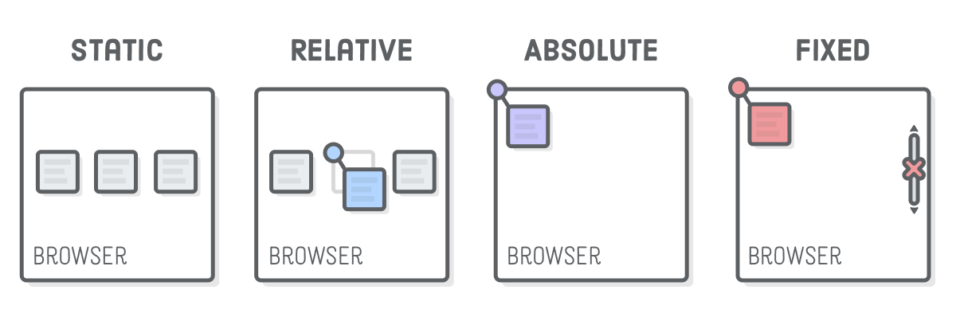
POSITION

Slide 11
Float
Mostly obsolete due to grid and flexbox, but sometimes still useful for quick columns. Float must be applied to both the left and right element.
float: left
float: right
float: right
float: left

Slide 12
CSS SELECTORS QUIZ

Slide 13

DON’T FORGET
TO RECORD

Slide 14
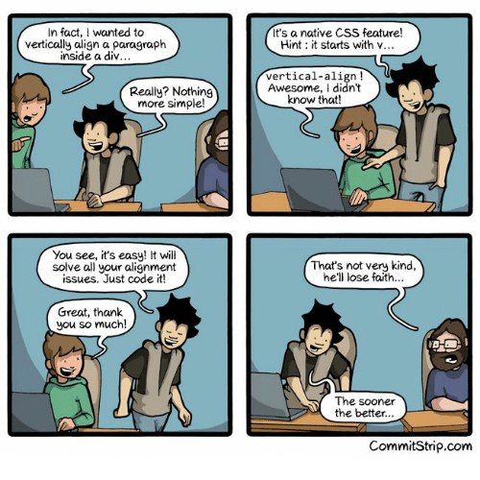
AGENDA
CSS Grid
Responsive Design
CSS Flexbox
Containers
Items
Media Queries

Slide 15
CSS Variables
CSS Variables work similar to variables in Java. They allow for values to be assigned to a reusable variable name.
Variables are created and assigned to the :root of the document.
:root { --top-row-height: 120px; --gutter: 20px; }
Variables can then be used in the CSS using the var() method with the variable name
p { height: var(--top-row-height); }

Slide 16
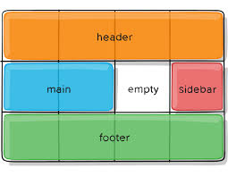
CSS Grid
CSS Grid Layout is a 2-dimensional system, meaning it can handle both columns and rows.
You work with Grid Layout by applying CSS rules both to a parent element (which becomes the Grid Container) and to that element’s children (which become Grid Items).

Slide 17
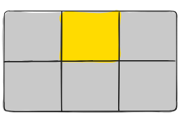
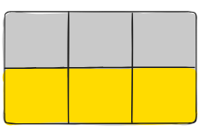
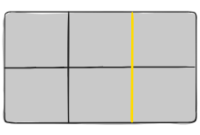
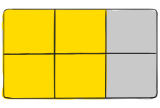
Grid Terminology
Grid Cell
The space between two adjacent row and two adjacent column grid lines. It’s a single “unit” of the grid.
Grid Track
The space between two adjacent grid lines. You can think of them like the columns or rows of the grid.
Grid Area
The total space surrounded by four grid lines. A grid area may be composed of any number of grid cells.
Grid Container
The element on which display: grid is applied.
Grid Item
The children (i.e. direct descendants) of the grid container.
Grid Line
The dividing lines that make up the structure of the grid. They can be either vertical (“column grid lines”) or horizontal (“row grid lines”) and reside on either side of a row or column.

Slide 18
Display
grid-template-columns
Defines the element as a grid container and establishes a new grid formatting context for its contents.
Values:
grid – generates a block-level grid
inline-grid – generates an inline-level grid
Defines the columns of the grid with a space-separated list of values. The values represent the track size, and the space between them represents the grid line
grid-template-columns: 4fr 1fr 2fr;
Columns can be a length, a percentage, or a fraction of the free space in the grid (using the fr unit)
Fractional Units ( fr ) is the preferred unit to allow the grid to correctly adjust for different display sizes.
.container {
display: grid | inline-grid;
}

Slide 19
grid-template-areas
grid-area
Grid template areas is where a developer can set up names for different sections of the defined grid. grid-template-areas is defined as a series of strings. Each string will have as many sections as there are columns defined and there will be a row created for each string in the sequence.
Grid Areas are applied to the Grid Items and identify the area of the grid the element should be displayed in.
div.header {
grid-area: header;
}
div.main {
grid-area: main;
}
div.sidebar {
grid-area: sidebar;
}
grid-template-areas:
"header header header"
"main . sidebar"
"footer footer copyright";

Slide 20
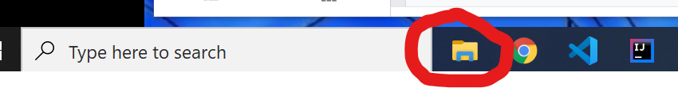
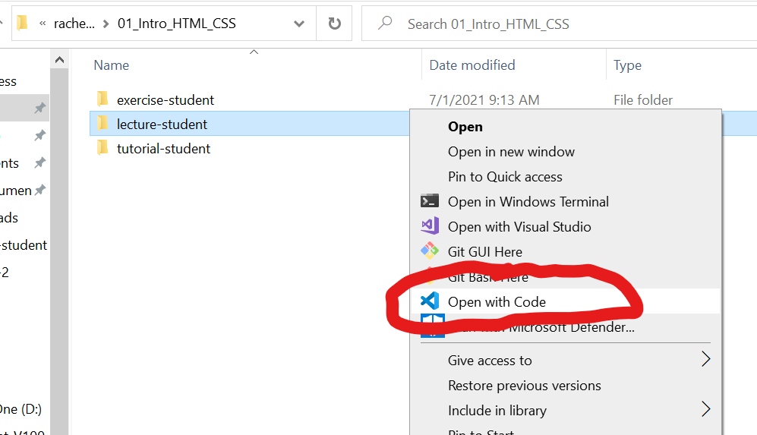
Let’s head to the code
Go to file explorer
Navigate to the lecture-student
Right click lecture-student folder
Select Open with Visual Studio Code
03_CSS_Grid_Flexbox

Slide 21
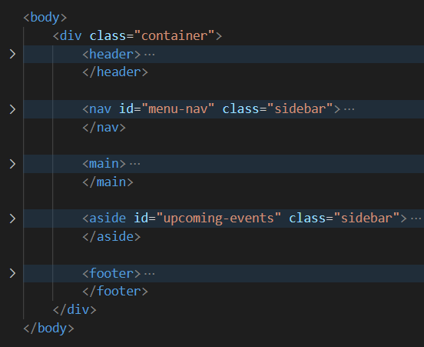
header
header
header
menu-nav
main
upcoming-events
footer
footer
footer

Slide 22
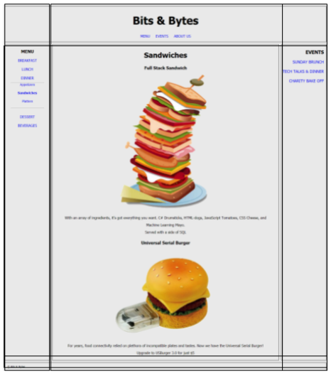
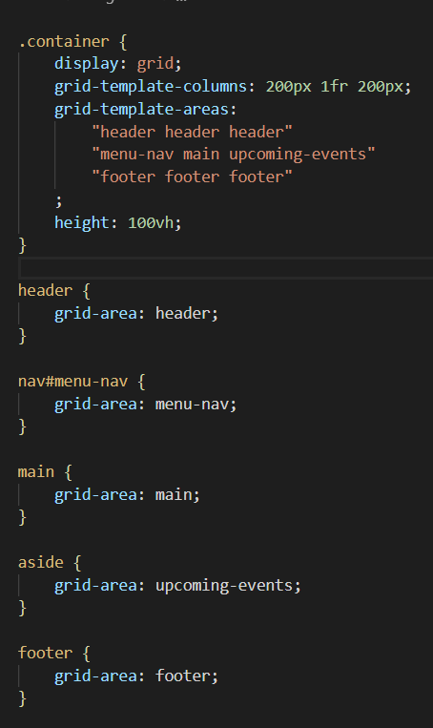
header
header
header
Like variables made up by us to represent the areas of our grid
menu-nav
main
upcoming-events
Note, the styling applied to these CSS Selectors assigns ‘this’ element to a certain grid-area ‘variable’ from above.
footer
footer
footer

Slide 23
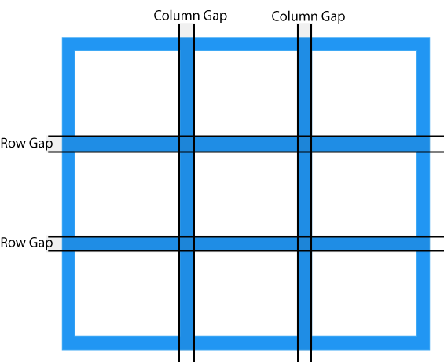
Grid Gap
Grid Gap is area between the grid tracks.
It can be defined as the gap between columns, the gap between rows, or for both columns and rows. Grid gap is applied to the container.
Grid Gap adds space between columns and rows, but not on the outer edges of the grid.
grid-column-gap: 10px;
grid-row-gap: 15px;
grid-gap: 20px;

Slide 24
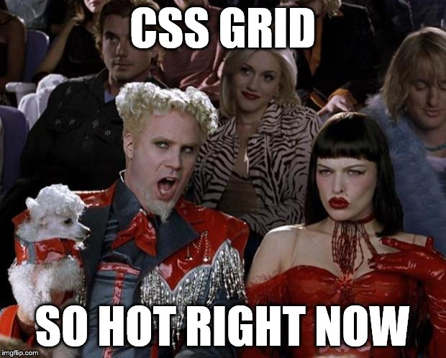
BREAK
DON’T FORGET TO PAUSE/UNPAUSE RECORDING

Slide 25


Responsive Design
Design for mobile first
Avoid fixed dimensions
Design for specific devices
phone
tablet
computer
Prioritize content differently for different devices
Use responsive sizing like em, rem, vh, and wh instead of absolute sizing like px
Use either min-width/height or max-width/height, but not both

Slide 26
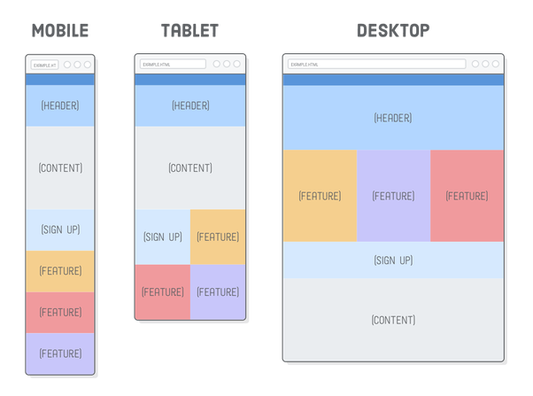
RESPONSIVE DESIGN

Slide 27
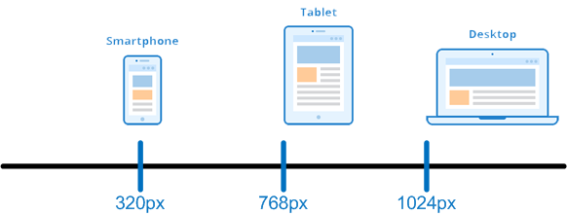
CSS Media Query
Creates conditional CSS that will be applied for different sizes of viewports, for example css that will be applied to a phone and different CSS that will be applied to a computer.
Achieved by creating breakpoints where we want to switch the CSS rules applied.
Documentation

Slide 28
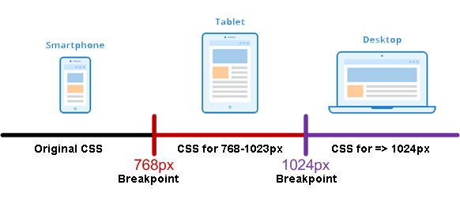
Breakpoints
Breakpoints are pixel sizes where the CSS “breaks” and changes to a different media query to adjust the presentation of the site.
Design for the smallest size first, then create a breakpoint for each device size where you want to change the layout.

Slide 29
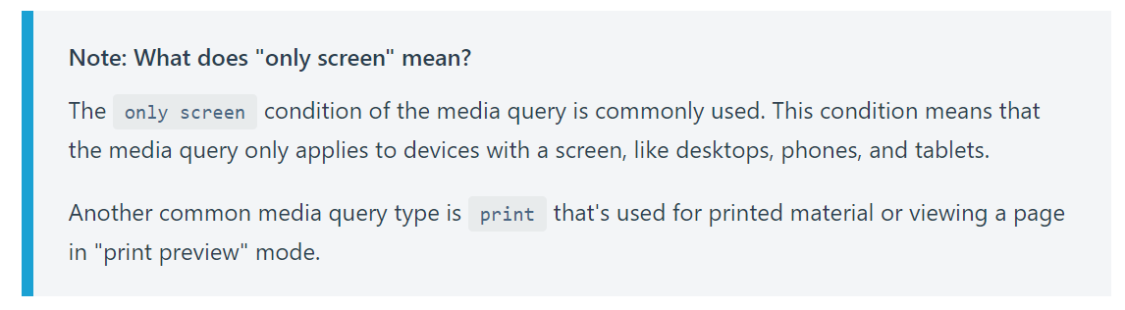
MEDIA QUERIES
Media Type
Expression to test
If the viewport is 600px or less
/* Extra small devices (phones, 600px and down) */
@media only screen and (max-width: 600px) {
display: flex;
}
Conditional CSS to apply

Slide 30
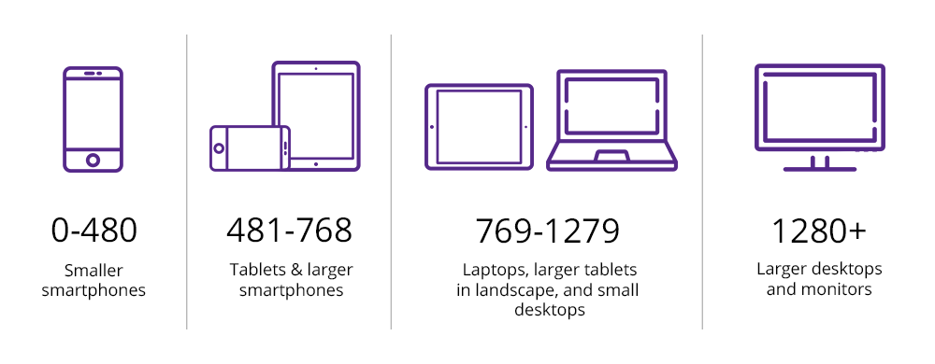
MEDIA QUERIES

Slide 31
HTML Viewport Meta Tag
Added in HTML5 - instructs the browser how to control page dimensions
Required for mobile/tablets to properly size, resize, and zoom a page
Current recommendation is to keep it minimal and use MediaQuery for sizing, unless you are working for an IOT (Internet of Things) application
Added to the <head> of an HTML document, and will almost always be the following:
<meta name="viewport" content="width=device-width, initial-scale=1">

Slide 32

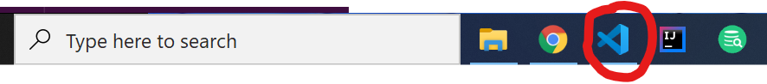
Let’s head back to the code

Slide 33
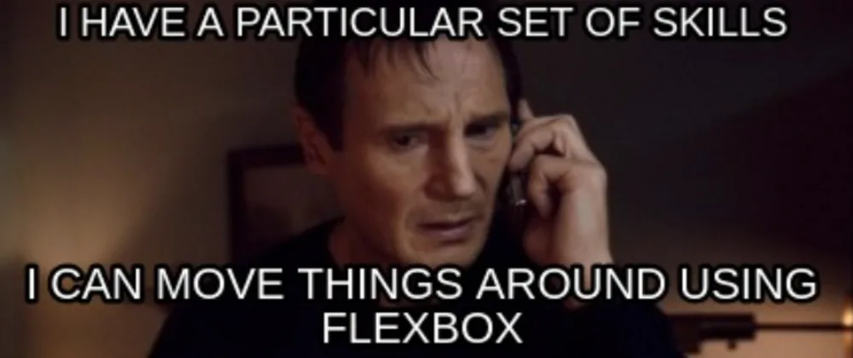
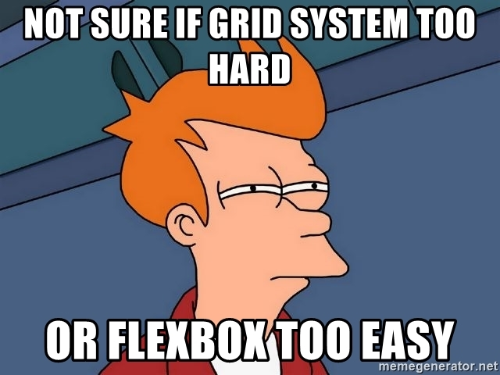
BREAK

Slide 34
Flexbox
Provides a more efficient way to lay out, align, and distribute space among items in a container, even when their size is unknown and/or dynamic.
The main idea behind the flex layout is to give the container the ability to alter its items’ width/height/order to best fill the available space. A flex container expands items to fill available free space, or shrinks them to prevent overflow.

Slide 35
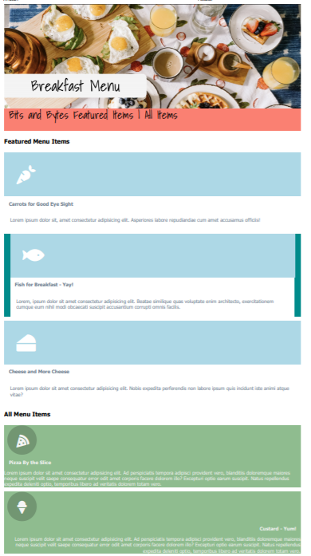
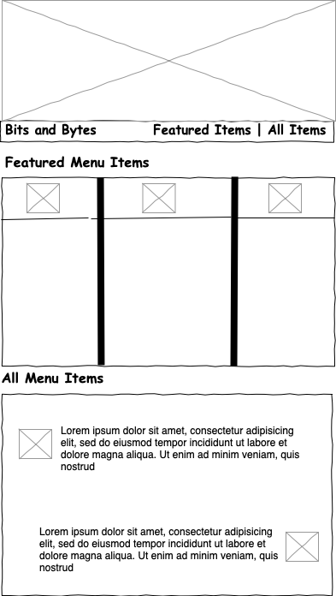
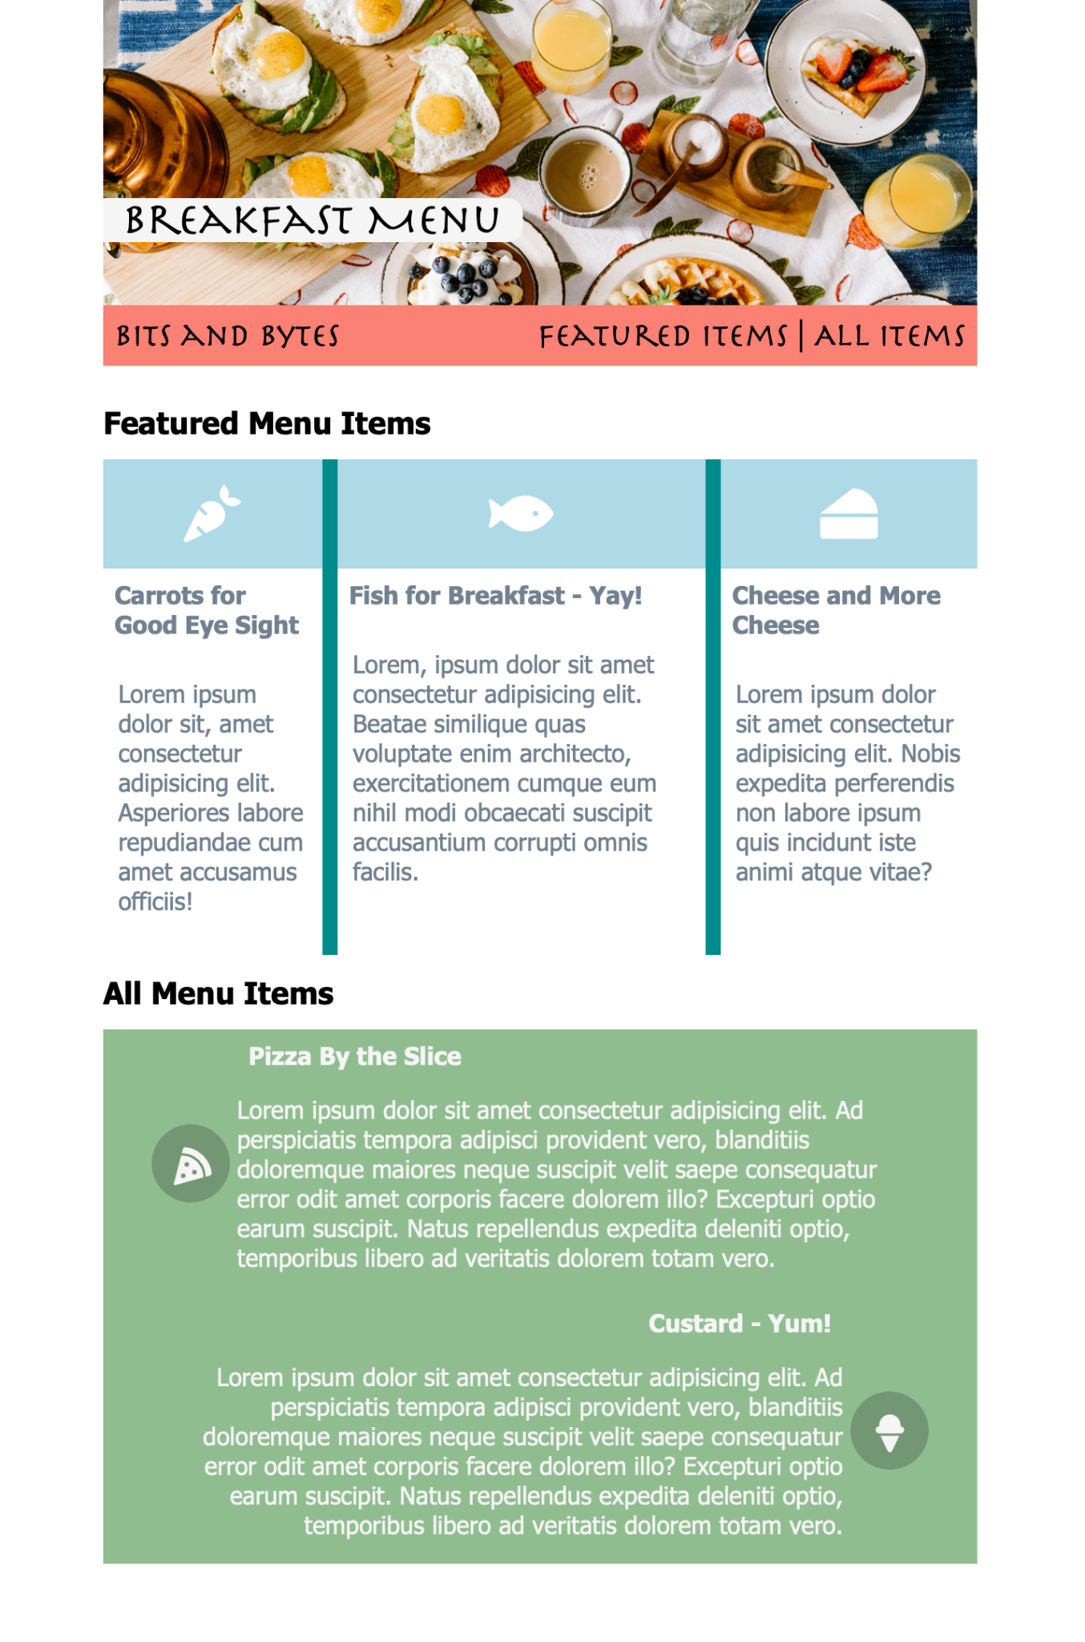

Slide 36

Let’s head back to the code

Slide 37
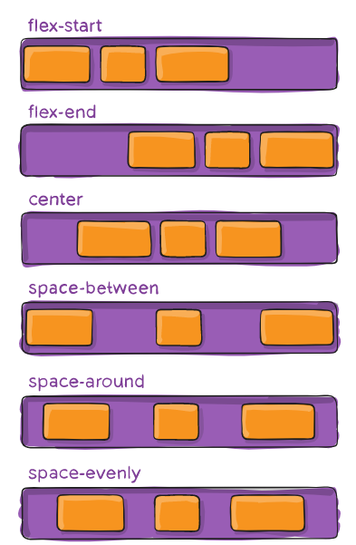
justify-content
Tells the flex container how to layout items on the main axis.

Slide 38
flex-direction
This establishes the main-axis, thus defining the direction flex items are placed in the flex container. Flexbox is (aside from optional wrapping) a single-direction layout concept. Think of flex items as primarily laying out either in horizontal rows or vertical columns.
row-reverse
column
column-reverse
row
Note that the usage of align-items and justify-content varies if the parent container has a flex-direction of column.
In most cases throughout this example, align-items centers content vertically because the flex-direction is set to row.

Slide 39
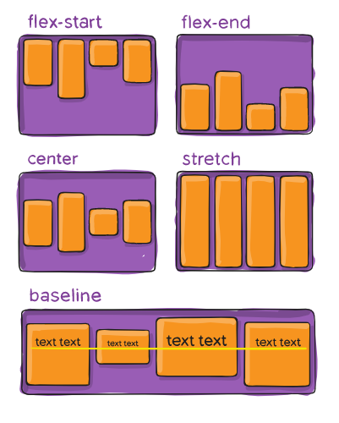
align-items
Tells a flex container how to layout items on the cross axis

Slide 40
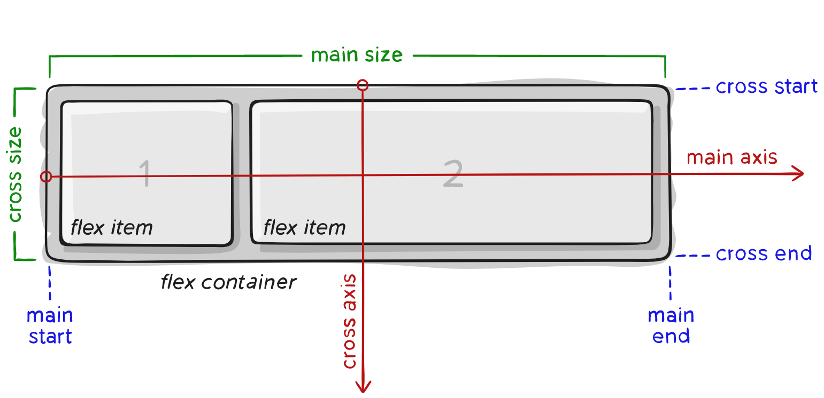
Flex Terminology

Slide 41
flex-wrap
Usually Flexbox will try to put all items on one row or column. Setting flex-wrap will tell the flex container that it can wrap the items onto multiple rows or columns.
nowrap (default): all flex items will be on one line
wrap: flex items will wrap onto multiple lines, from top to bottom.
wrap-reverse: flex items will wrap onto multiple lines from bottom to top.

Slide 42
order
Applied to flex items instead of the container.
Flex items are displayed in the same order as they appear in the source document by default. The order property can be used to change this ordering.
.flex-item {
order: 2;
}

Slide 43

BREAK?

Slide 44
flex-basis
Applied to flex items instead of the container.
It specifies the initial size of the flex item, before any available space is distributed according to the flex factors. The optimal size of an flex item before it is added to the flexbox. It is limited by max/min width. When omitted from the flex shorthand, its specified value is the length zero.
A flex-basis value set to auto sizes the element according to its size property (which can itself be the keyword auto, which sizes the element based on its contents).
.flex-item {
flex-basis: 100px;
}
Flex-Basis

Slide 45
flex-shrink
Applied to flex items instead of the container.
It specifies the “flex shrink factor”, which determines how much the flex item will shrink relative to the rest of the flex items in the flex container when there isn’t enough space on the row.
When omitted, it is set to 1 and the flex shrink factor is multiplied by the flex basis when distributing negative space.
.flex-item {
flex-shrink: 2;
}

Slide 46
flex-grow
Applied to flex items instead of the container.
It defines the ability for a flex item to grow if necessary. It accepts a unitless value that serves as a proportion. It dictates what amount of the available space inside the flex container the item should take up.
For example, if all items have flex-grow set to 1, every child will set to an equal size inside the container. If you were to give one of the children a value of 2, that child would take up twice as much space as the others.
.flex-item {
flex-grow: 2;
}

Slide 47
align-self
Applied to flex items instead of the container.
It makes possible to override the align-items value for specific flex items.
The align-self property accepts the same 5 values as the align-items:
flex-start: cross-start margin edge of the item is placed on the cross-start line
flex-end: cross-end margin edge of the item is placed on the cross-end line
center: item is centered in the cross-axis
baseline: items are aligned such as their baseline are aligned
stretch (default): stretch to fill the container (still respect min-width/max-width)
.flex-item {
align-self: flex-end;
}
justify-self for the main axis is still in development. Would you like to hear more?

Slide 48
Flexbox Resources
CSS Tips: Complete Guide Flexbox
Flexbox Zombies (requires free account)

Slide 49
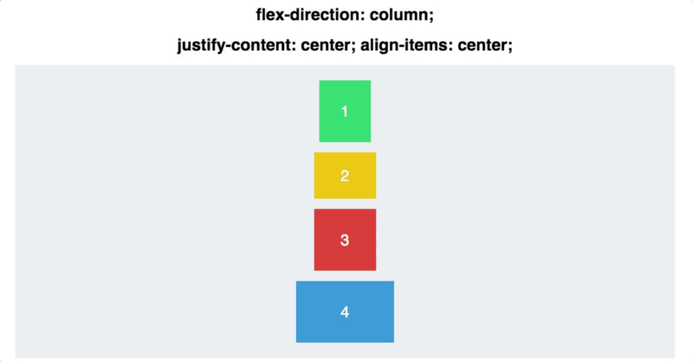
FREE CODE CAMP
Notes:
https://www.freecodecamp.org/news/an-animated-guide-to-flexbox-d280cf6afc35/

Slide 50
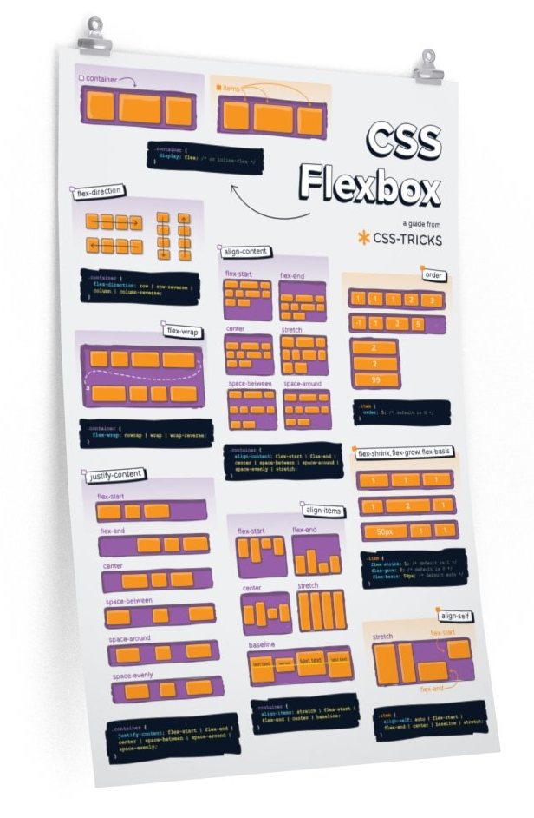
FLEXBOX CHEAT SHEET
Notes:
https://css-tricks.com/snippets/css/a-guide-to-flexbox/

Slide 51
CSS Grid Links
CSS Tricks: Complete Guide to Grid comprehensive documentation with examples
CSS Grid Garden game to learn Grid
Layoutit! grid layout tool
Holy Grail Layout using Grid to achieve the web’s most desired layout

Slide 52
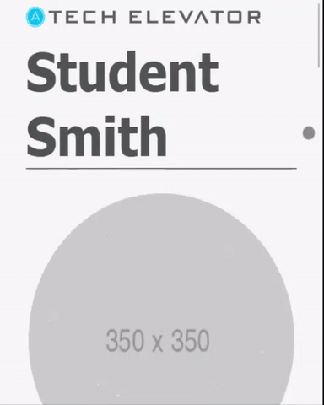
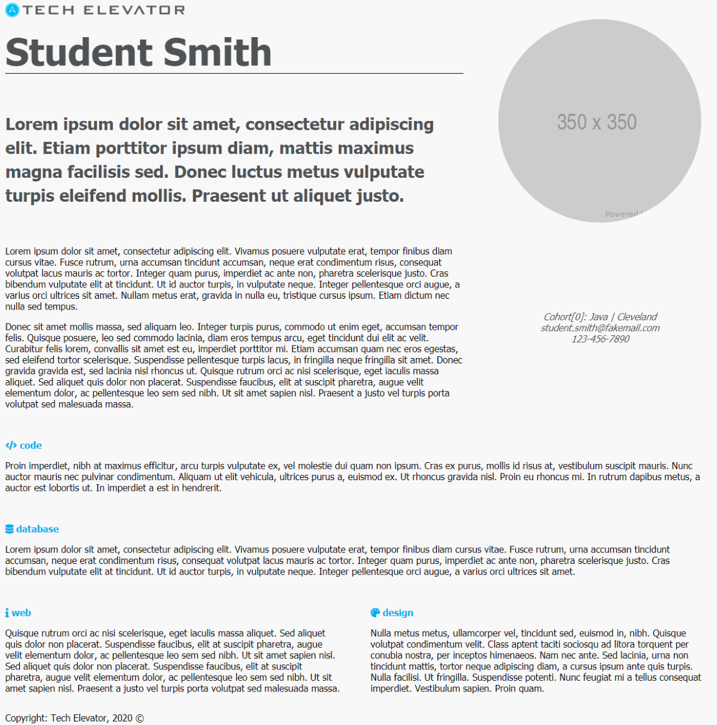
STUDENT EXERCISE

Slide 53
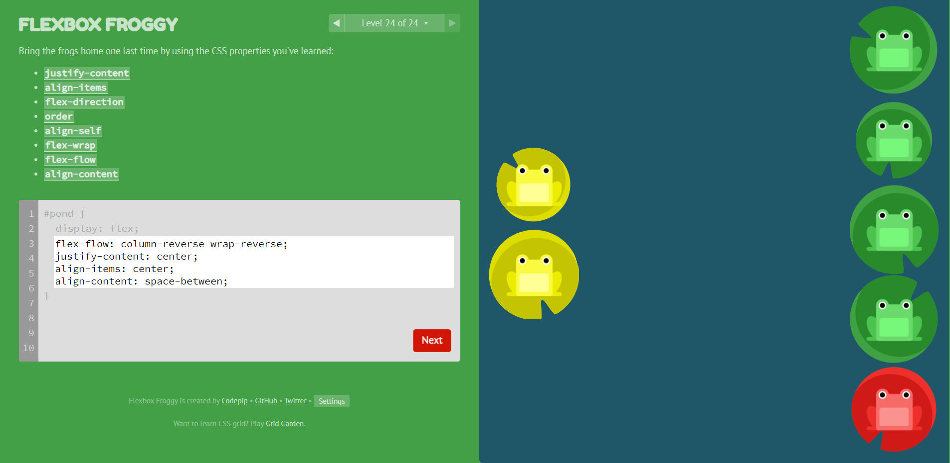
STUDENT EXERCISE

Slide 54

HAPPY CODING!

